Slide 1

Team 9
0930300039
Andrew Xu
Dream Heart
1030300022
Jen Liang
An android application about RPG game
1030300021
Shelvin Liang
1030300052 Harry Yan

Slide 2







01
06
Demo
02
Introduction
Model and
setting
07
Q & A
03
05
Interactivity
Technology
and Tools
04

Slide 3
01
Name: Dream Heart
Introduction
Storybroad:
Sandy is a 14-years-old girl. She is active and loves adventure. Everytime she went to sleep, she would dream. In the dream, she is a young warrior. And her aim is to kill different kinds of monsters in different levels successfully to get a treasure called 'Dream heart' . The treasure is help her to come out of the dream...
home

Slide 4
06
DEMO
Thank you for listening...
Here is the DEMO time...
home

Slide 5
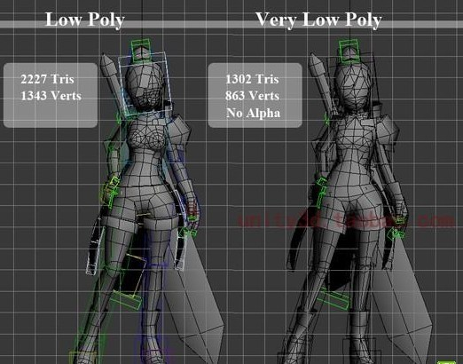
Model and
Setting
03
We adjusted the parameters of the model including animation, bones and transformation.

Slide 6
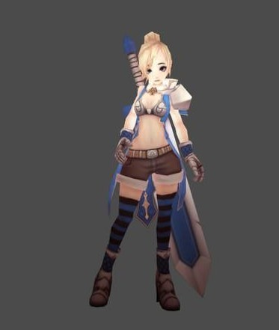
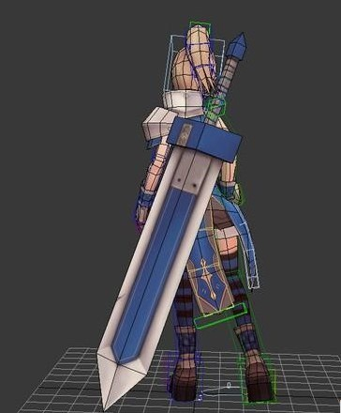
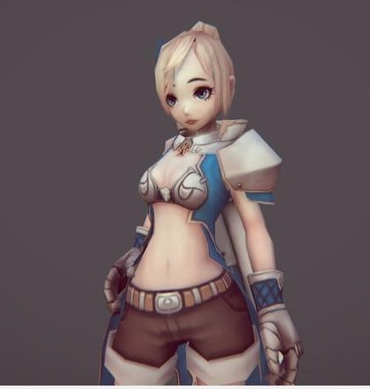

Slide 7
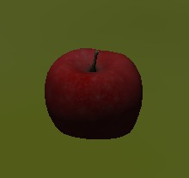
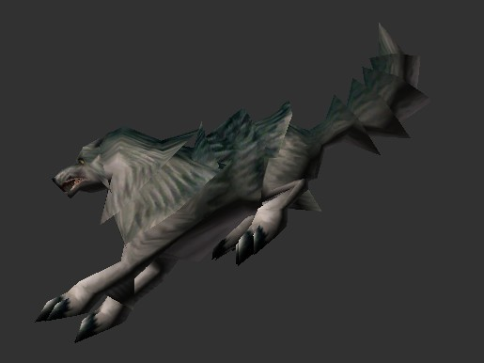

Slide 8
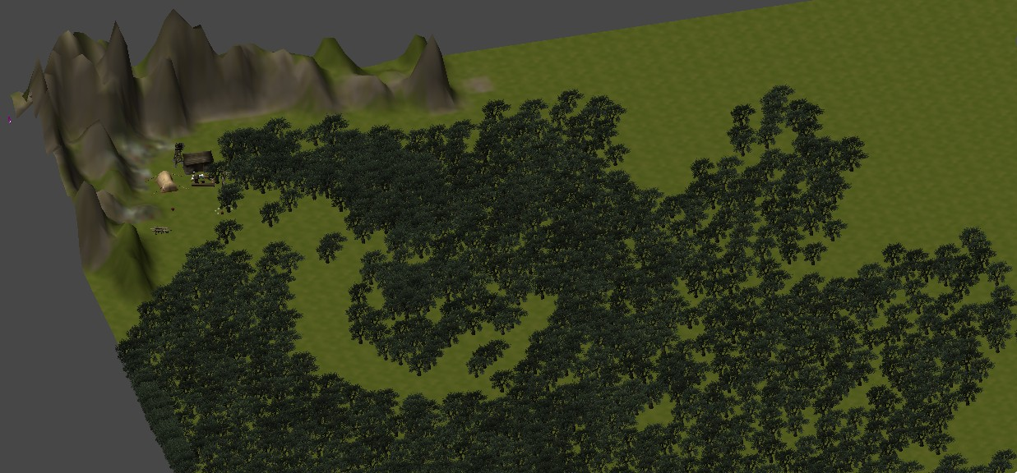
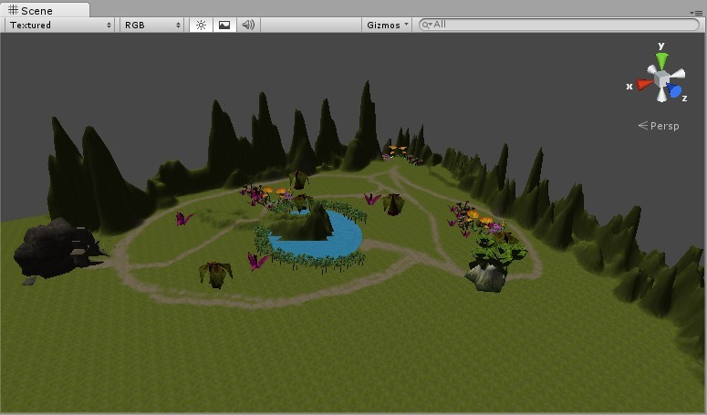
We have more
scenes to show…
home

Slide 9
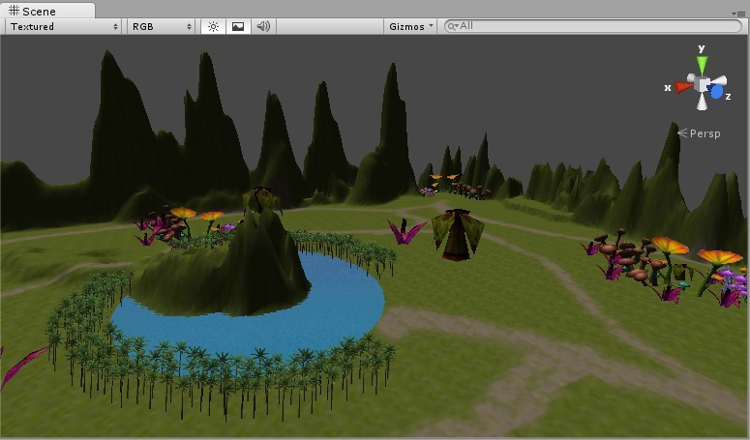
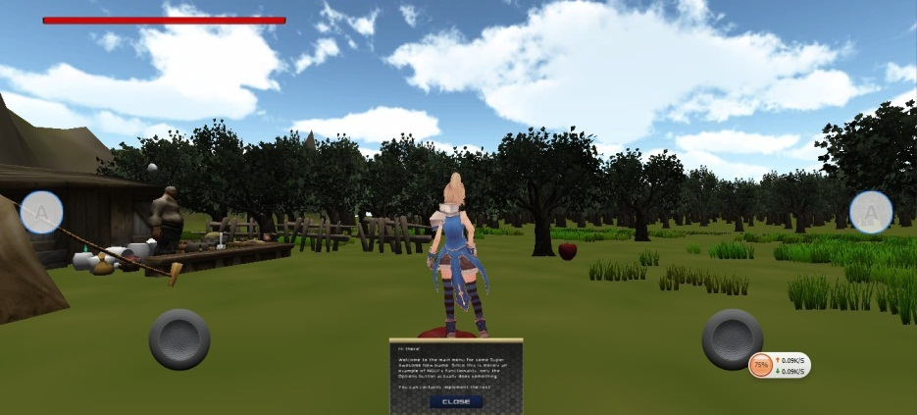
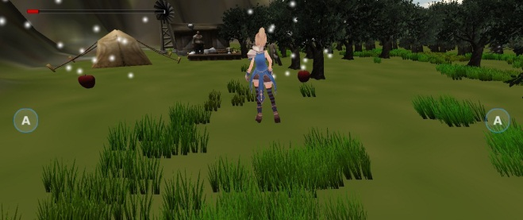
02
We have more UI ...
Expect in Demo time
home

Slide 10
Question and Answer
07
Q & A
home

Slide 11
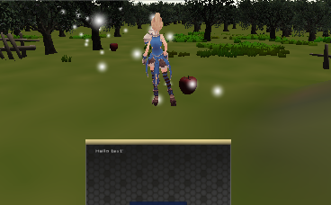
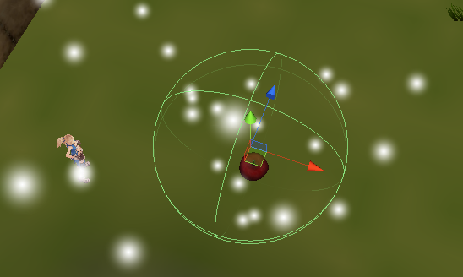
Trigger
Dialog
Interactivity
Trigger by Collider
04
home

Slide 12
Knapsack
AI
05
Technology
and Tools

Slide 13
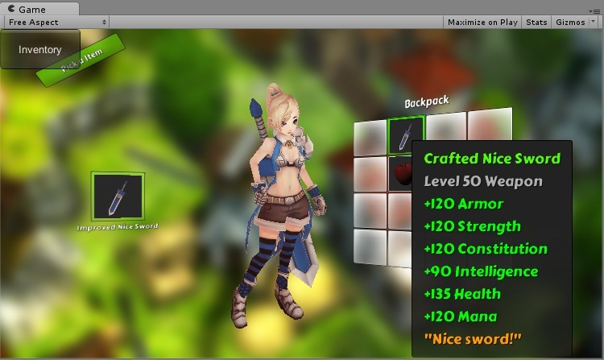
1.If the character walks nearly than the circle, and the player press the apple. Then character (will send a message)can pick the apple up and put it in the knaspack.
2. Put the apple in the database based on the ID of the apple()
(pickable object)
exmple: Apple
3.In the database, we classfiy the items.

Slide 14
Of course, the life bar will decrease if you were hurt no matter human or monster.
VisionRange
(If the human in the range, the monster will run to human)
human
monster
Attack range(If human in the range, the monster will attack human)

Slide 15
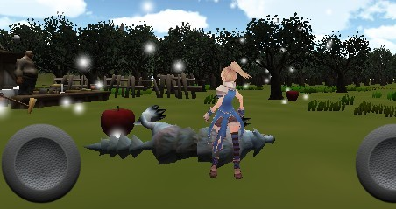
home

